Slide 1
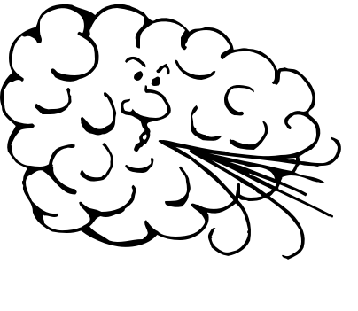
WIND

Slide 2
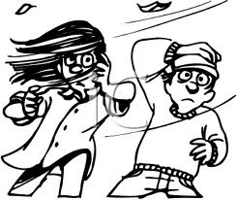
What is wind?
• moving air
• horizontal movement of air from an area of high pressure to an area of low pressure
•winds can be
local or global

Slide 3
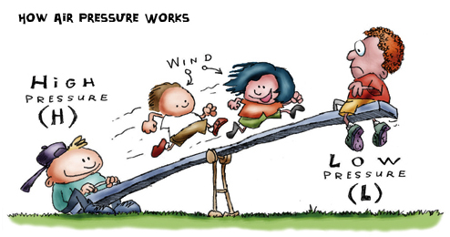
Areas of high pressure push towards areas of low pressure.
Remember this?

Slide 4
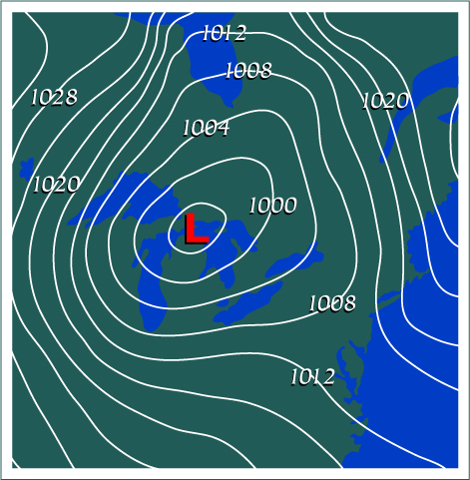
Do you remember how temperature affects air pressure?

Slide 5
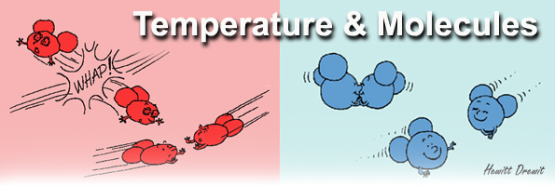
Temperature affects pressure
Heat causes molecules to move faster.
Moving faster increases the amount of collisions between individual molecules and the relative force of those collisions.
More force results in more pressure.
Faster moving molecules exert greater pressure on a rigid container. If there is no container, then faster molecules will move apart.

Slide 6
Temperature affects pressure
Faster air molecules move apart (expand) and become less dense (more buoyant)
A less dense, warmer air mass has lower air pressure
A less dense, warmer air mass will rise when buoyed up by a denser air mass
A cooler air mass is more dense
A cooler air mass will sink
What is this process
called?

Slide 7
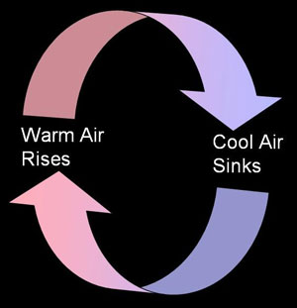
CONVECTION!
Convection currents form in the atmosphere because of the unequal heating of Earth’s surface by the sun.
When fluids of different densities come in contact, the denser fluid
sinks beneath the less
dense fluid and the less
dense fluid rises, cools,
increases in density and
sinks…..round & round

Slide 8
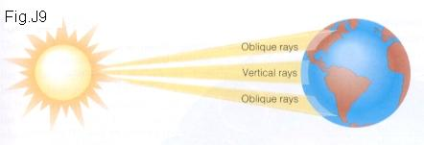
What causes wind?
Differences in air pressure cause wind
Differences in air pressure are caused by the uneven heating of Earth’s surface because incoming solar radiation concentrates at the equator and not so much at the poles

Slide 9
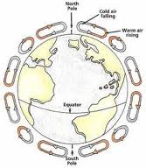
What causes wind?
Air pressure differences cause air to move (wind to blow) from areas of high pressure to areas of low pressure
Humidity affects air pressure, too. Humid air is less dense than dry air. (counterintuitive, but true!)
Winds blow at different altitudes and
latitudes
Some winds are local
Some winds are global
Watch this:
Bill Nye Wind video clip:
http://youtu.be/uBqohRu2RRk

Slide 10
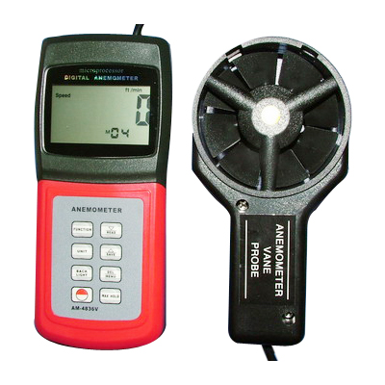
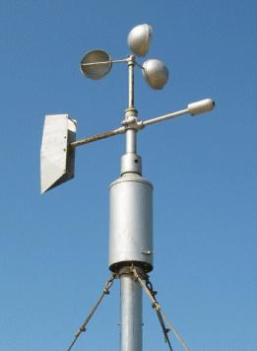
Measuring Wind
Anemometer (an uh MOM eh ter) is a wind speed measuring device

Slide 11
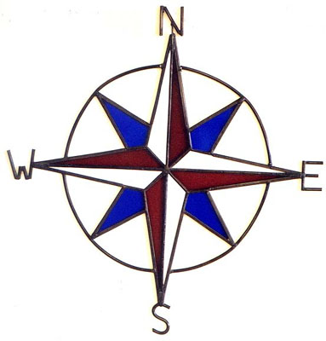
Wind direction
Wind direction tells you where the wind is coming from
North wind blows from north to south
Southwest wind blows from southwest to northeast
Never eat soggy waffles!

Slide 12
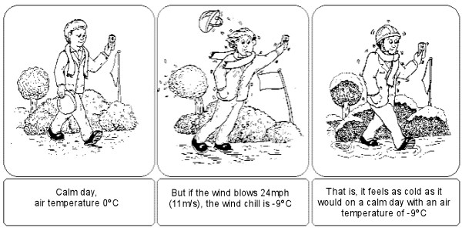
Wind-Chill Factor
Measures the cooling effect of wind
Cooling effect is due to heat loss
Wind blowing over skin removes body heat causing heat loss which may be pleasant in summer, but not so much in winter

Slide 13
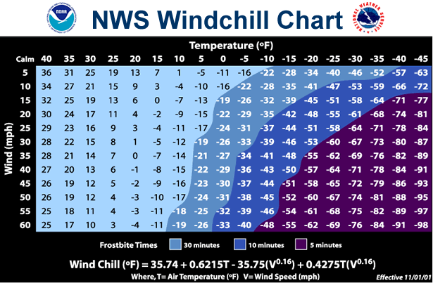
http://www.nws.noaa.gov/os/windchill/index.shtml

Slide 14
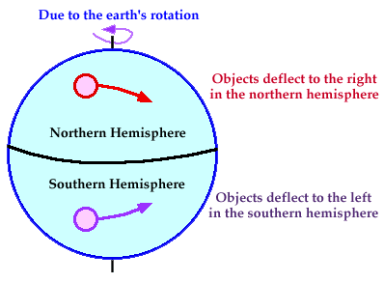
Coriolis Effect
Winds don’t blow straight because of Earth’s rotation. Earth’s rotation affects the motion of air and water.
Spinning deflects winds to the right in the Northern Hemisphere and to the left in the Southern Hemisphere
Most at poles
None at equator

Slide 15
Coriolis Effect video clips:
Coriolis Effect
Coriolis Effect
Coriolis and other animations, interactives
Coriolis Effect Animation

Slide 16
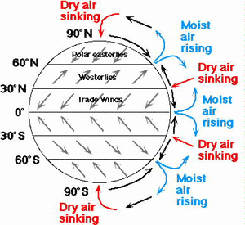
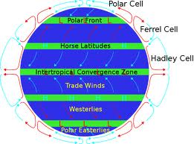
Global Winds
Blow steadily from a specific direction
Created by uneven heating of Earth’s surfaces
Movement of air between equator and poles in giant convection cells
Also include areas of decreased wind activity
Hot, humid air at equator rises creating low pressure area...stops rising when density of hot, humid air mass equals air masses around....can’t go up because up is less dense, can’t go down because down is more dense, so it goes sideways at higher altitudes...towards poles....as it moves to higher latitudes, air cools, becomes more dense and sinks....sinks to lower altitudes and begins to move back towards poles...higher pressure to lower pressure

Slide 17
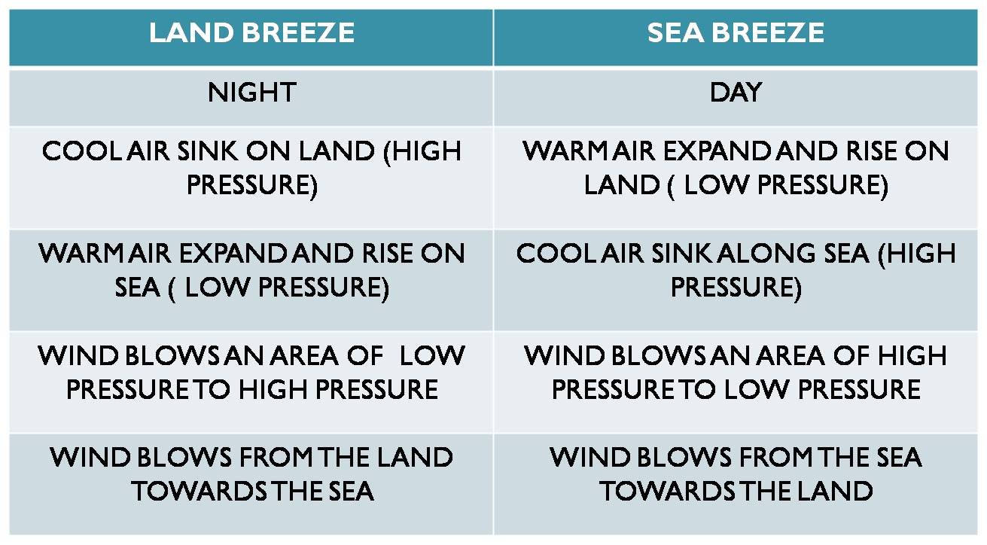
Local Winds
Blow over short distances
Caused by unequal heating in small area
Influenced by geography –> shoreline, mountain

Slide 18
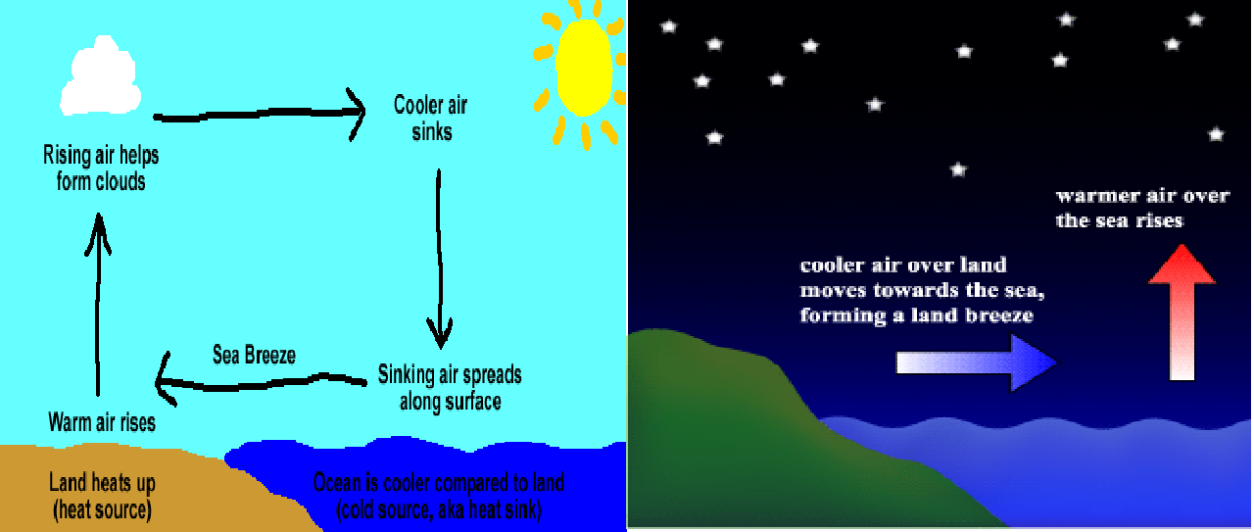
Sea and Land Breezes
Click here for Sea and Land Breezes Animation

Slide 19
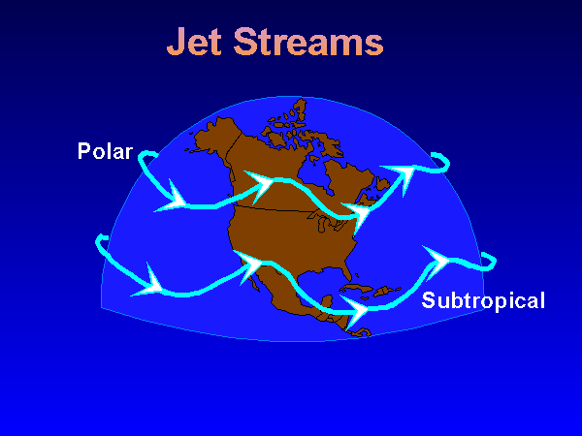
Jet Streams
Bands of high-altitude, high-speed winds in upper troposphere/lower stratosphere
Blow west to east 200 – 400 km per hour

Slide 20
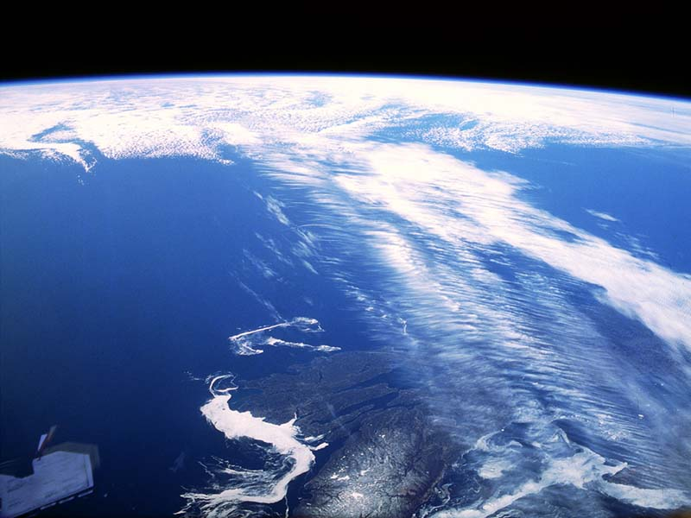
Jet Streams
Shift north & south along wavy paths
caused by high-altitude air pressure differences at different latitudes
Reason major weather systems move west to east

Slide 21
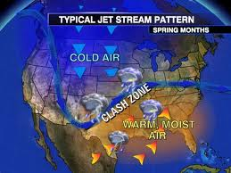
Jet Stream video clip:
http://youtu.be/CgMWwx7Cll4

Slide 22
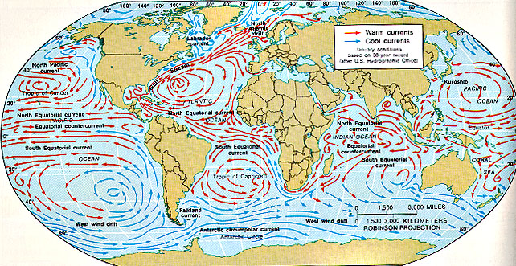
Ocean Currents are also affected by the Coriolis Force
NASA Dynamic Planet
NASA Perpetual Oceans

