Slide 1
Waves Review
Science 7

Slide 2
Question 1
A disturbance that transmits energy through matter or space is called a_________.
Wave

Slide 3
Question 2
Give one example of a medium that is a
Solid
Liquid
Gas
Solid-Wall
Liquid- Water
Gas- Air

Slide 4
Question 3
The particles in a longitudinal wave vibrate ________ along the path that the wave travels.
Back and forth/ parallel

Slide 5
Question 4
What two wave types combine to form a surface wave?
Transverse and longitudinal

Slide 6
Question 5
What is the SI unit for frequency?
Hertz

Slide 7
Question 6
A wave that travels through the ground is called a ____________.
Seismic wave

Slide 8
Question 7
What type of wave does NOT require a medium?
Electromagnetic

Slide 9
Question 8
Where is a trough located? Draw the wave and label the trough.
Bottom of a transverse wave

Slide 10
Question 9
If the wavelength increases, the frequency of a wave___________.
Decreases

Slide 11
Question 10
One complete back and forth motion of an object is called a __________.
Vibration

Slide 12
Question 11
Fill in the blanks. Waves carry __________, not _________.
Energy, Matter

Slide 13
Question 12
Why can’t we hear someone talking in space?
Sound is a mechanical wave
No medium in space

Slide 14
Question 13
What type of a wave is a compression and rarefaction found in?
Longitudinal

Slide 15
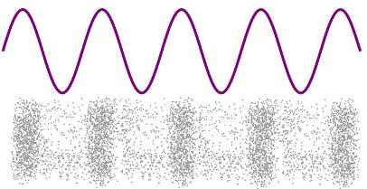
Question 14
What type of wave does picture B represent?
A
B

Slide 16
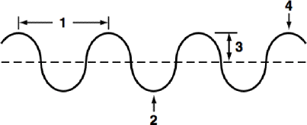
Question 15
What does number 1 represent in this picture?

Slide 17
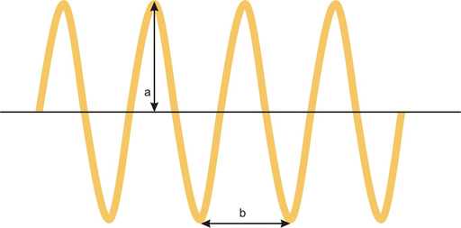
Question 16
What does a represent in this picture?

Slide 18
Question 17
What unit do we measure the amplitude of a wave in?
Metric

Slide 19
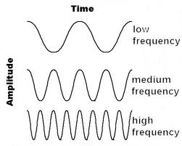
Question 18
Which of the following waves has the most energy?
A
B
C
C

Slide 20
Question 19
___________ is found by counting the number of crests or troughs in a given amount of time.
Frequency

Slide 21
Question 20
Give two examples of electromagnetic waves.
Light, microwaves, x-rays

Slide 22
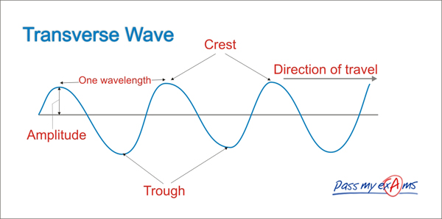
Draw and label the wave

Slide 23
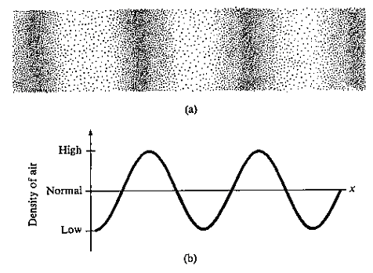
Label the parts of the wave

