Slide 1
The Atom

Slide 2
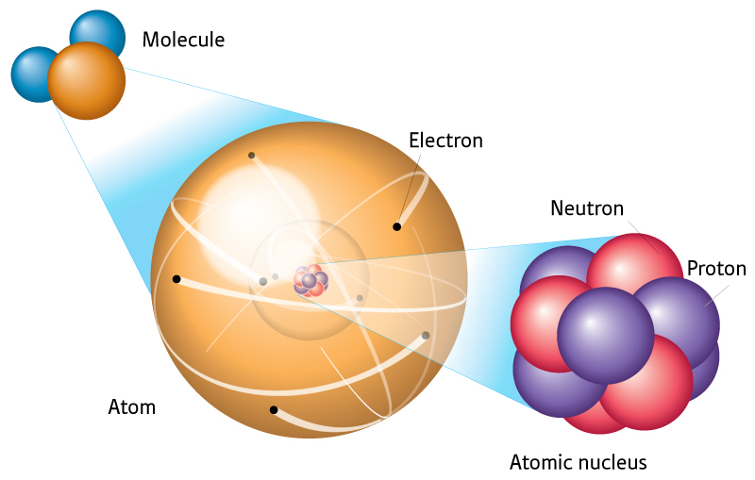
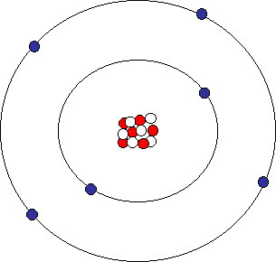
Nucleus
The center of the atom
Has a positive charge
What gives it this positive charge?

Slide 3
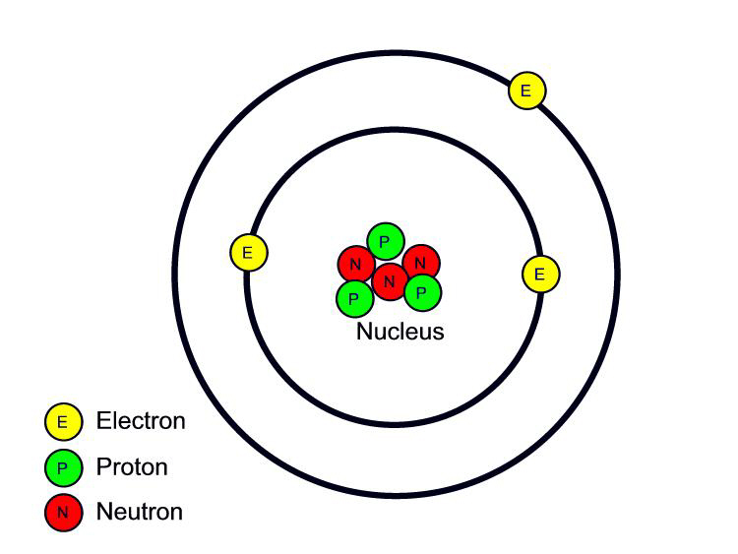
Proton
Positively charged
Located in the nucleus

Slide 4
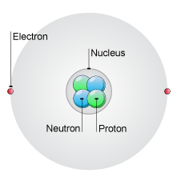
Neutron
No electrical charge
Neutral
Located in the nucleus

Slide 5
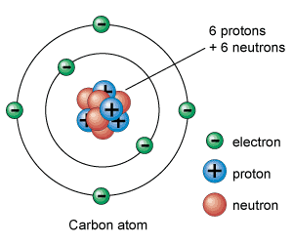
Electron
Negatively charged
Surround the nucleus
Electron clouds

Slide 6
Atomic Mass Unit
The SI unit used to express the masses of the particles in an atom
Proton = 1 amu
Neutron = 1 amu
Electron = negligible

Slide 7
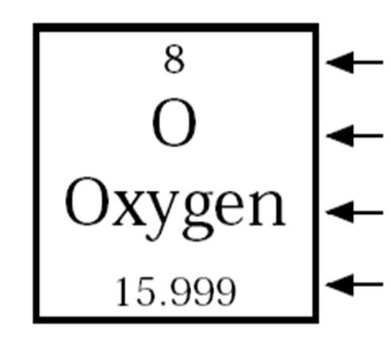
Atomic Number
The number of protons in an atom
Identifies the atom as a particular element
Atomic Number

Slide 8
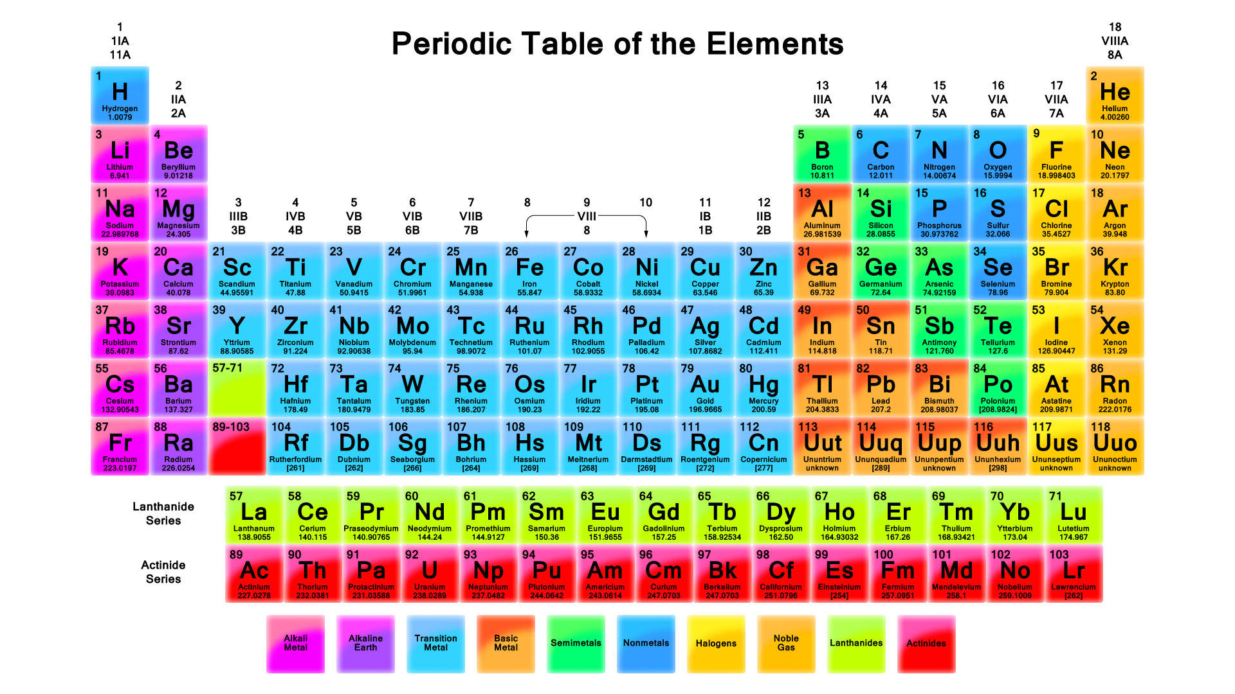

Slide 9
Mass Number
The sum of the protons and neutrons in an atom

Slide 10
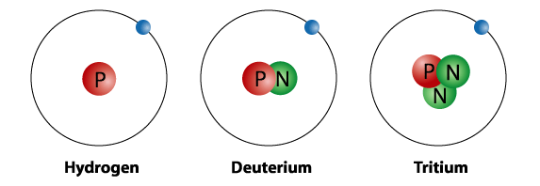
Isotopes
Atoms that have the same number of protons but different number of neutrons
Share most of the same properties

Slide 11
Atomic Mass
Weighted average of the masses of all the isotopes of an element
Atomic Mass

Slide 12
Atomic Number
# of _________________ and # of
_________________
Chemical Symbol
Name of Element
# of _________________ +
_________________
Atomic Mass

Slide 13
# of protons = ________
# of electrons = ________
# of neutrons = ________
Cu

Slide 14
Cool Video
http://www.youtube.com/watch?v=DZGINaRUEkU

