Slide 1
How Observant Are You ?

Slide 2
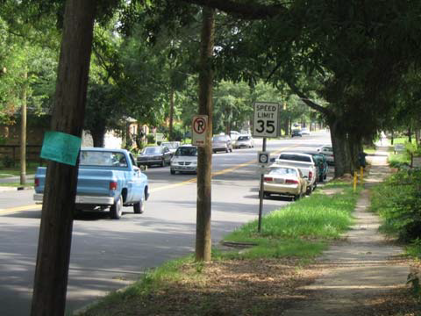
Take a good look at this picture.

Slide 3
Questions
Are there cars parked on the side of the road?
What color is the pickup truck driving in the road?
Are there any minivans around?
Which way is the arrow pointing on the no parking sign?
What is the speed limit?
Are there any pedestrians on the road?

Slide 4
Answers ?
Yes
Blue
Yes
Right
35 mph
No

Slide 5
How many legs does the elephant have?

Slide 6
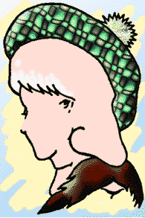
What do you see?
Hint : There are 3 images !
An old lady
A young woman
A man with a big brown mustache.

Slide 7
Where are these dots coming from?

Slide 8
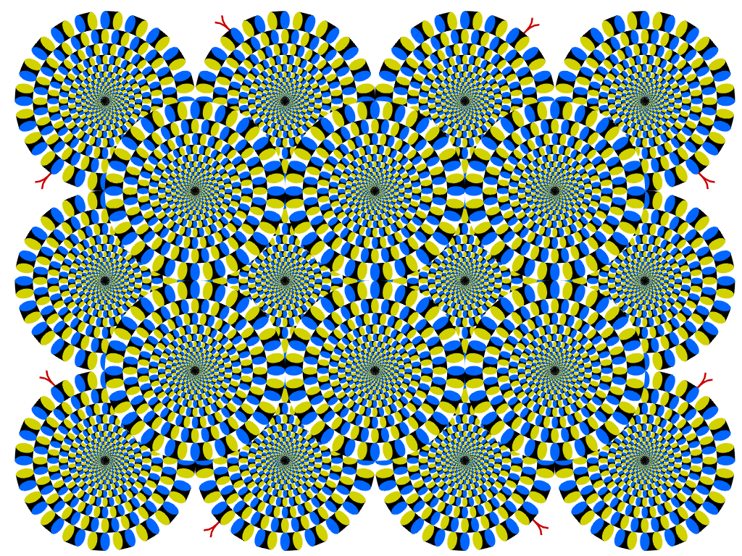
These circles are not moving, your brain is making them appear to move. Focus on one circle.

