Slide 1
Heredity

Slide 2
Heredity
The passing of traits from parents to offspring

Slide 3
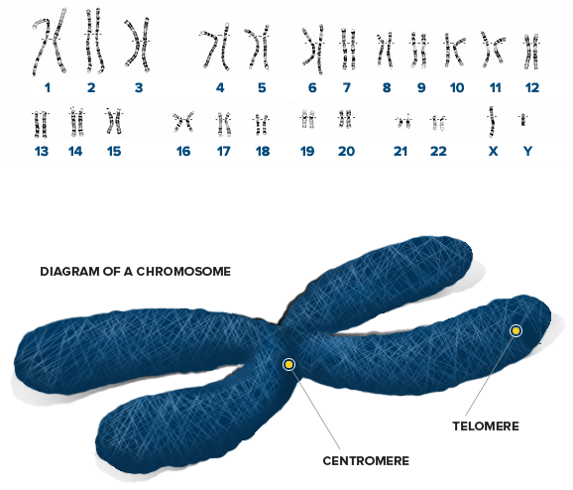
Chromosomes
Each human cell has 46 chromosomes
The only exception is the sperm and egg, they only have 23

Slide 4
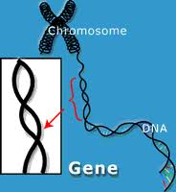
Genes
On the chromosomes there are genes
These genes carry the instructions
Humans have 20,000-25,000 genes

Slide 5
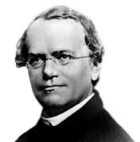
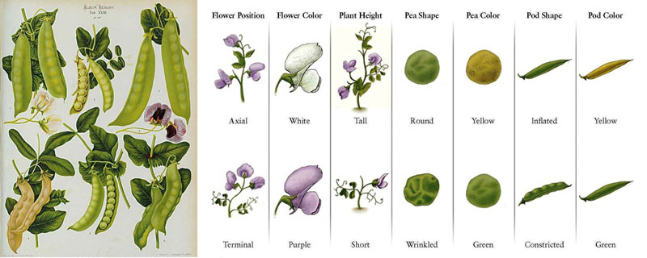
Alleles
I’m Gregor Mendel, the father of genetics.
Two forms of the gene
Examples for pea plants:

Slide 6
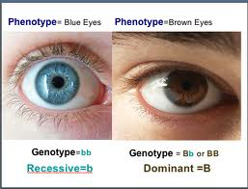
Two Types of Traits
Dominant – observed with only one allele present
Recessive – observed only when two alleles are present
Use capital and lowercase letters to represent these:
BB
Bb
bb

Slide 7
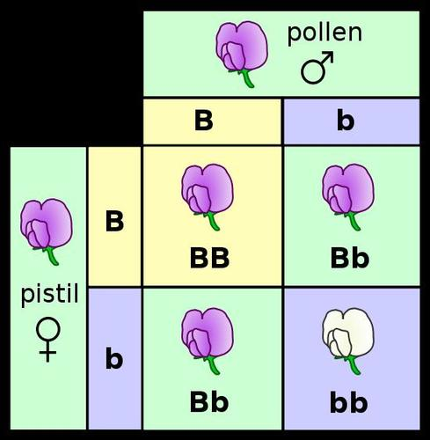
Punnett Square Example

Slide 8
TOOLS TO KNOW
PARENT’S GENES
A PUNNET SQUARE IS A TOOL USED TO PREDICT THE POSSIBLE GENOTYPES FOR THE OFFSPRING OF TWO KNOWN PARENTS.
PARENT’S GENES

Slide 9
HOW TO USE A MONOHYBRID (ONE TRAIT) PUNNETT SQUARE
THE PARENTS’ ALLELES GO ON THE OUTSIDE OF THE SQUARE
B
B
BB X bb
b
b

Slide 10
HOW TO USE A MONOHYBRID (ONE TRAIT) PUNNETT SQUARE
THE PARENTS’ ALLELES GO ON THE OUTSIDE OF THE SQUARE
DROP THE LETTERS ON THE TOP, INTO EACH SQUARE
B
B
b
B
b
B
b
MOVE EACH LETTER ON THE SIDE, INTO EACH SQUARE
THE ORDER DOES NOT MATTER IN THE BOXES, BUT UPPERCASE FIRST IS A GOOD RULE
b
B
b
B
b

Slide 11
HOW TO USE A MONOHYBRID (ONE TRAIT) PUNNETT SQUARE
WHAT DO THE RESULTS SHOW?
RESULTS:
B
B
PHENOTYPIC: 100% BLACK
4:0 RATIO, BLACK TO BROWN
IF B IS THE DOMINANT ALLELE FOR BLACK
b
Bb
Bb
AND b IS THE RECESSIVE ALLELE FOR BROWN
GENOTYPIC:
100% Bb
4:0 ALL Bb
b
Bb
Bb
THEN WE CAN MAKE PREDICTIONS ABOUT THE OUTCOMES

Slide 12
TERMS TO KNOW
ALLELES | DIFFERENT FORMS OF A TRAIT THAT A GENE MAY HAVE | T,t
HOMOZYGOUS | AN ORGANISM WITH TWO ALLELES THAT ARE THE SAME | TT, tt
HETEROZYGOUS | AN ORGANISM WITH TWO DIFFERENT ALLELES FOR A TRAIT | Tt, Gg

Slide 13
TERMS TO KNOW
HYBRID | SAME AS HETEROZYGOUS | Tt, Gg
DOMINANT | A TRAIT THAT DOMINATES OR COVERS UP THE OTHER FORM OF THE TRAIT | REPRESENTED BY AN UPPERCASE LETTER T OR G
RECESSIVE | THE TRAIT BEING DOMINATED OR COVERED UP BY THE DOMINATE TRAIT | REPRESENTED BY A LOWER CASE LETTER t or g

Slide 14
TERMS TO KNOW
PHENOTYPE | THE PHYSICAL APPEARANCE OF AN ORGANISM (WHAT IT LOOKS LIKE) | TALL, SHORT, GREEN, WRINKLED
GENOTYPE | THE GENE ORDER OF AN ORGANISM (WHAT ITS GENES LOOK LIKE) | TT, GG, Tt, gg Gg, tt
RATIO | THE RELATIONSHIP IN NUMBERS BETWEEN TWO OR MORE THINGS | 3:1, 2:2, 1:2:1

Slide 15
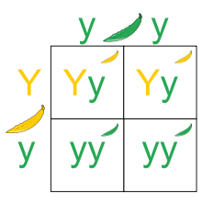
Punnett Square Example

