Slide 1
Experimental Design

Slide 2
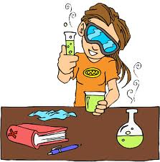
Experiments
An organized procedure for testing a hypothesis under controlled conditions.

Slide 3
Experiments
An experiment contains:
At least two variables
A variable can have more than a single value

Slide 4
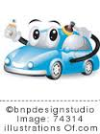
Experiments
Independent Variable – the factor adjusted by the experimenter.
I can change
Which car wax will make my car the shiniest?
What would be the IV in the above scenario? What would you change????
The brand of car wax!

Slide 5
Experiments
Dependent variable – the factor that depends on the independent variable.
It is what you are measuring.
What were you measuring when testing the car wax?
How shiny the car is.

Slide 6
Experiments
Control – a standard for comparison that does not receive the independent variable.
The control for the previous experiment is…..
Using no car wax

Slide 7
Experiments
Constants – factor that does not change
Some constants for the car wax example might be:
Same car
Same person
Same amount of wax
Amount of time wax is on the car

Slide 8
Experiments
Problem: Which fertilizer will help my plants grow the tallest?
Hypothesis: If I use Miracle Grow then my plant will be the tallest.

