Slide 1
Diffusion and Osmosis

Slide 2
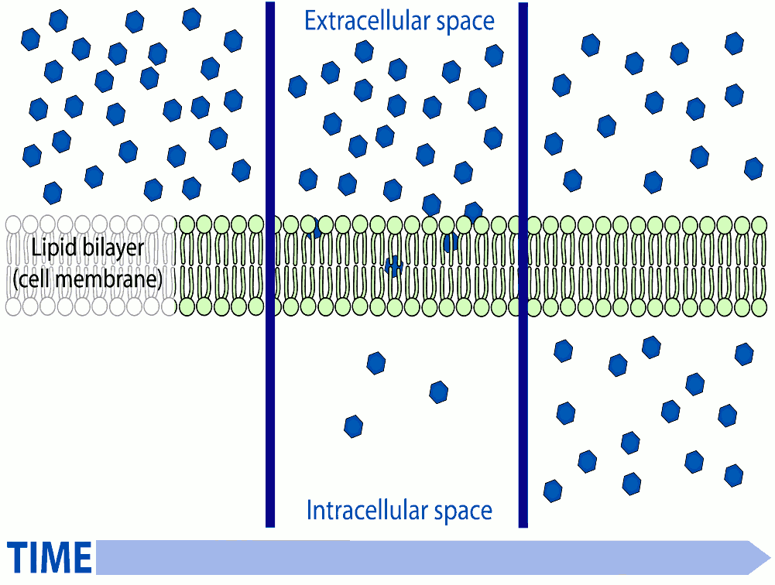
Diffusion and Osmosis
The exchange of materials in and out of a cell
This occurs through the cell membrane

Slide 3
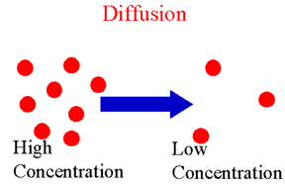
Diffusion
Movement of particles from an area of high concentration to an area of low concentration
Particles want to move from very crowded areas to less crowded areas
Example – spraying air freshener in a room

Slide 4
http://highered.mcgraw-hill.com/sites/0072495855/student_view0/chapter2/animation__how_diffusion_works.html
http://www.brainpop.com/science/matterandchemistry/diffusion/preview.weml

Slide 5
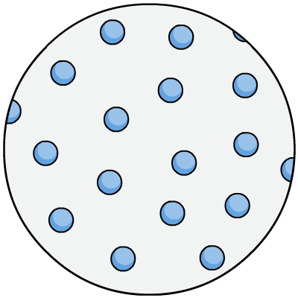
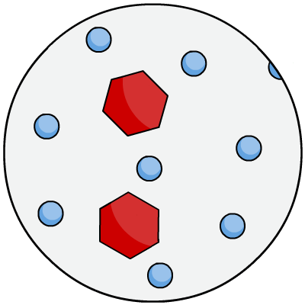
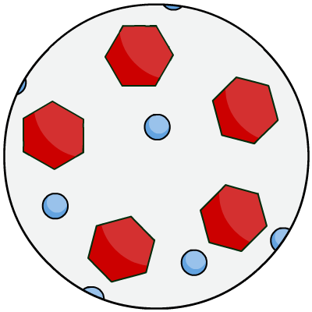
Osmosis
The diffusion of water through a cell membrane
concentrated
solution
pure water
dilute solution

Slide 6
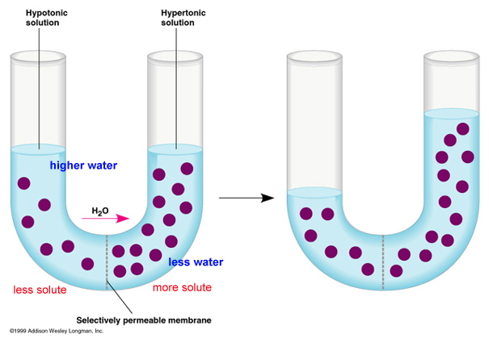
Osmosis

