Slide 1
Describing Matter
Physical and Chemical Properties

Slide 2
Physical and Chemical Properties
Describes a substance based on its ability to change into a new substance
CHEMICAL
Can be observed or measured without changing the identity of the matter
PHYSICAL

Slide 3
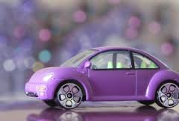
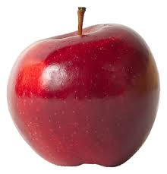
Physical or Chemical?
Color
Red apple
Purple car
Reactivity
The ability to react with another substance (water)
PHYSICAL
CHEMICAL

Slide 4
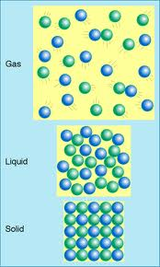
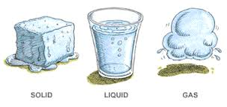
Physical or Chemical?
State of matter
Solid
Liquid
Gas
PHYSICAL

Slide 5
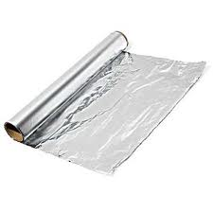
Physical Properties
Malleability
Ability to be pounded into thin sheets
PHYSICAL

Slide 6
Physical or Chemical?
pH
How acidic or basic a substance is
Scent/odor
Smell of fresh laundry
Stench of old shoes
CHEMICAL
PHYSICAL

Slide 7
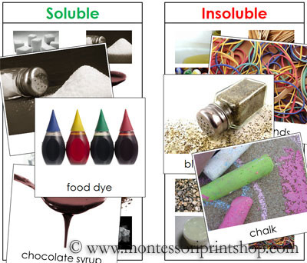
Physical or Chemical?
PHYSICAL
Conductivity
Ability to allow current to pass through
Solubility
The ability to dissolve in another substance
PHYSICAL

Slide 8
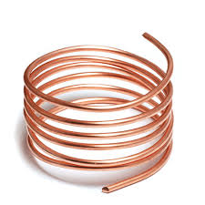
Physical or Chemical?
Flammability
The ability to burn
Ductility
Ability to be drawn into wire
CHEMICAL
PHYSICAL

Slide 9
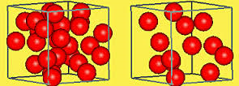
Physical Properties
Density
The amount of matter in a given space or volume
Density = mass / volume
Units:
g/mL, kg/L, g/cm³
PHYSICAL

Slide 10
Review
What do the two boxes have in common?

Slide 11
Review
What is the volume of a box with a mass of 5 g and a density of 15 g/cm³?

Slide 12
Review
What is the mass of a liquid with a volume of 7 ml and a density of 70 g/ml?

