Slide 1
Chapter 1 – The Energy of Waves

Slide 2
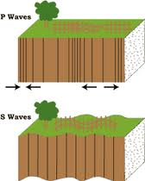
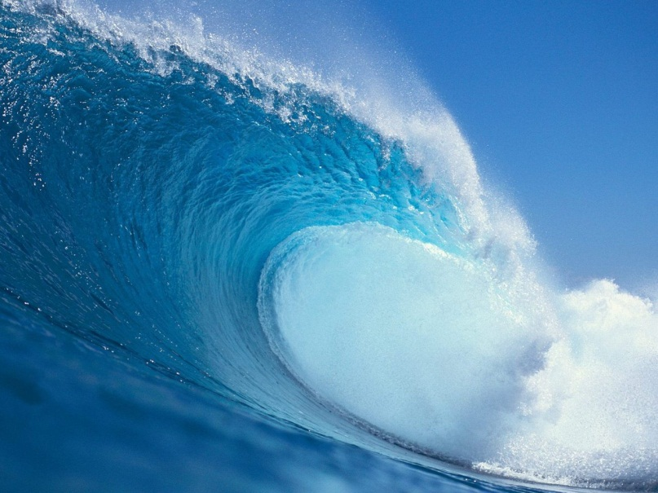
Wave
Any disturbance that transmits energy through matter or space
Examples:
Sound
Light
Water
Microwaves
Seismic waves

Slide 3
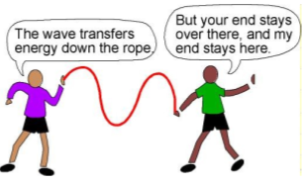
What do waves carry?
Waves carry ENERGY
NOT matter

Slide 4
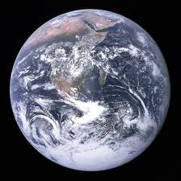
Medium
Medium – anything a wave can travel through
Solid – wall
Liquid – water
Gas – air

Slide 5
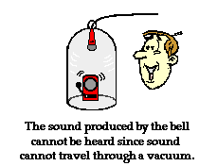
Mechanical Waves
Mechanical waves must have a medium
Sound is a mechanical wave
Can you hear someone talking in space?

Slide 6
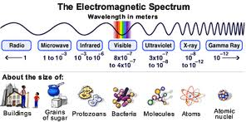
Electromagnetic Waves
Electromagnetic waves do not require a medium
Light
TV and radio waves
Microwaves
UV waves

Slide 7
Transverse Waves
The particles vibrate with an up and down motion
Particles travel perpendicular to the direction of the wave
EM waves are transverse

Slide 8
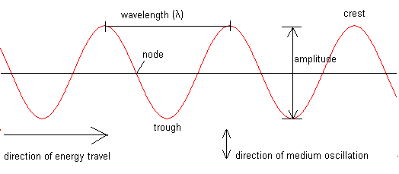
Transverse Waves
Crest – highest point
Trough – lowest point

Slide 9
Longitudinal Waves
The particles of the medium vibrate back and forth along the path that the wave travels
Particles travel parallel to the direction of the wave

Slide 10
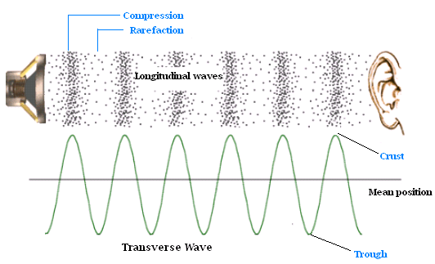
Longitudinal Waves

Slide 11
Combination Waves
Surface waves
Water
Particles travel in a clockwise motion

Slide 12
BrainPop
Brain Pop - Waves
Education Portal - Waves

