Slide 1
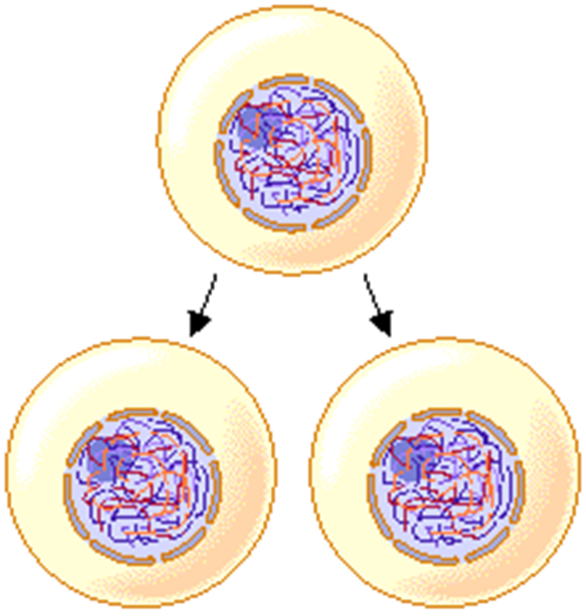
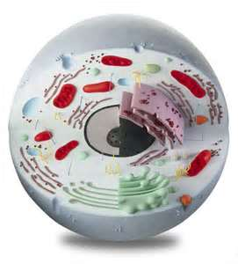
Cell Theory
All living things are made up of cells.
They form the building blocks of organisms.
All cells come from pre-existing cells.

Slide 2
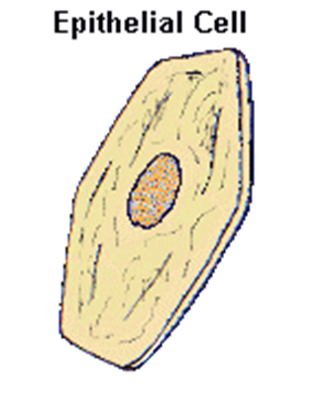
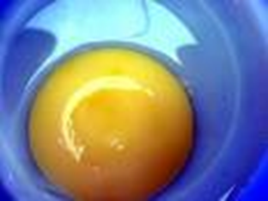
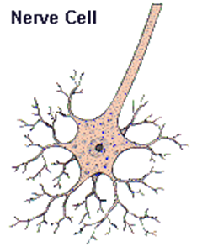
Cells
Cells come in many shapes and sizes.
They can be as small as 1 millionth of a meter or as large as the yolk of a bird’s egg.
Cell Size and Scale

Slide 3
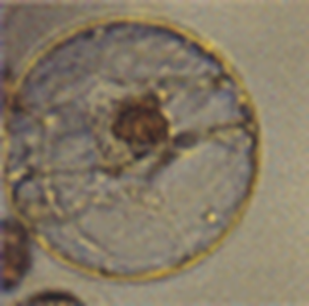
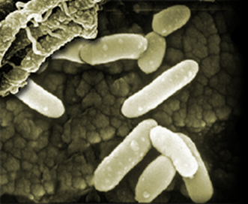
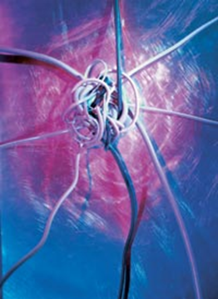
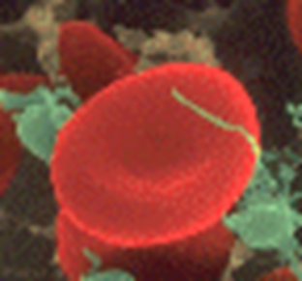
Examples of Cells
Amoeba Proteus
Plant Stem
Bacteria
Red Blood Cell
Nerve Cell

Slide 4
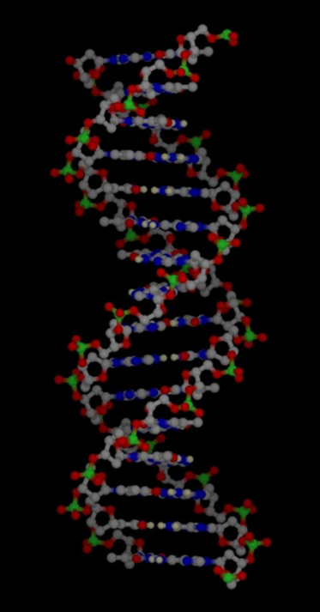
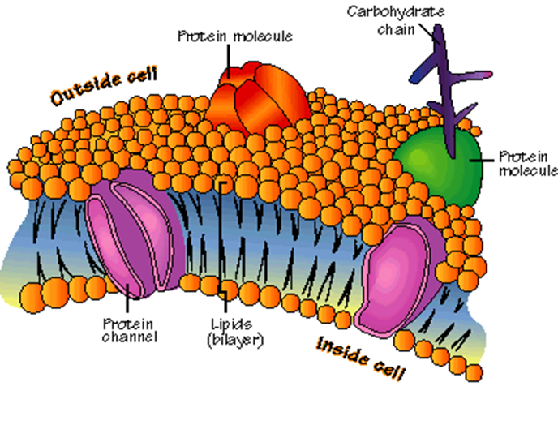
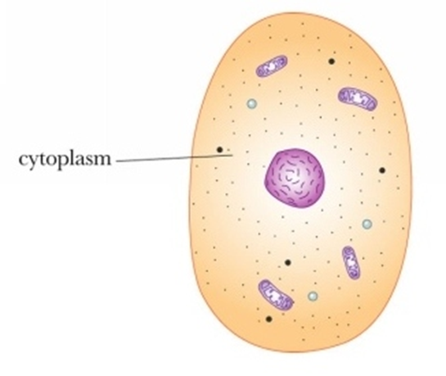
Cells
All cells have in common:
cell membrane
hereditary material (DNA)
organelles
cytoplasm

Slide 5
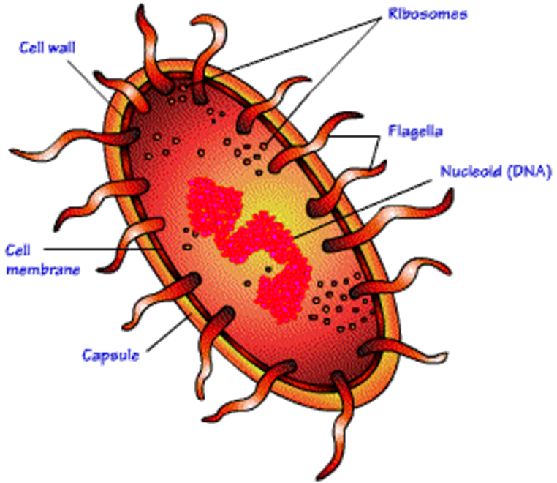
Types of Cells
Prokaryotic
no nucleus
no membrane covered organelle
circular DNA
bacteria

Slide 6
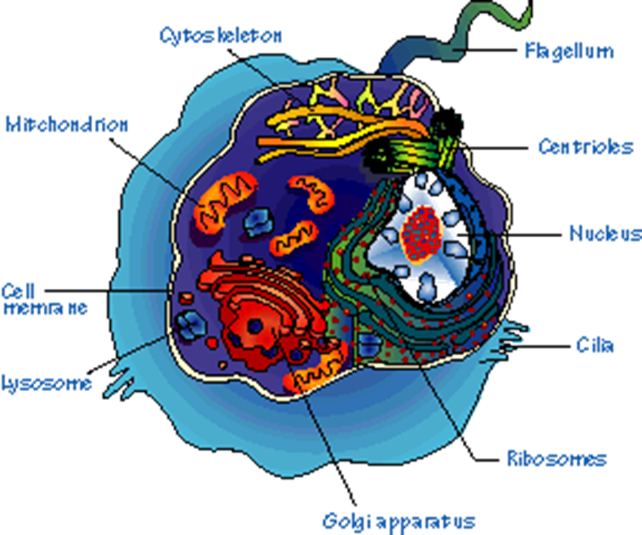
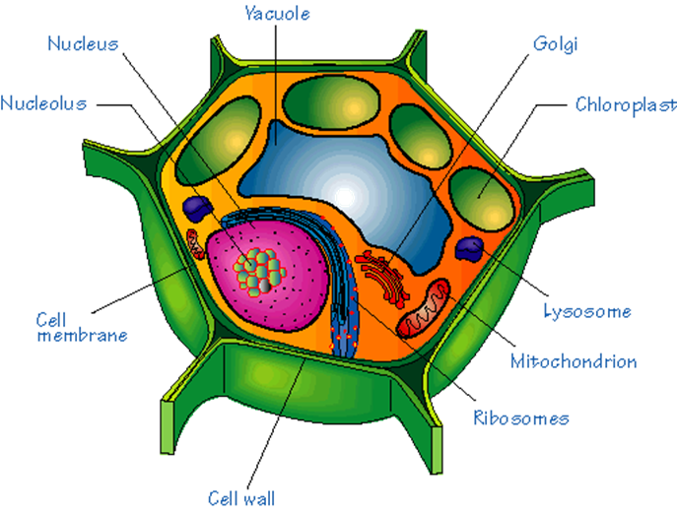
Types of Cells
Eukaryotic
contains a nucleus
membrane-covered organelles
linear DNA
animals, plants, fungus

Slide 7
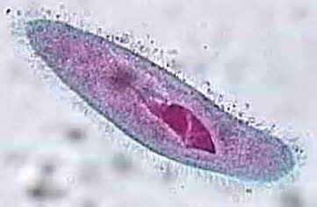
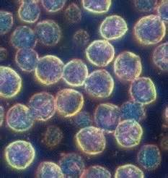
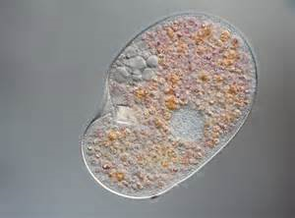
Types of Cells
Unicellular organism – an organism made up of only one cell
Examples :
Amoeba
Bacteria

Slide 8
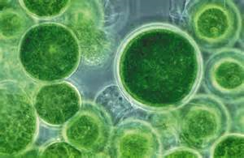
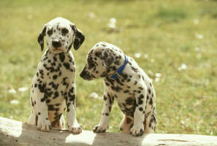
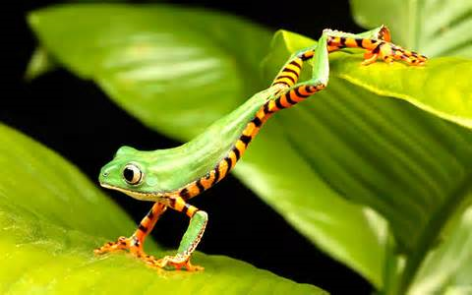
Types of Cells
Multicellular organism – an organism made of two or more cells
Examples –
Mammals
Birds
Fish
reptiles

Slide 9
Surface Area to Volume Ratio
It compares the cell’s outer surface to it’s volume.
This ratio will DECREASE as the cell grows.
Above a certain size, material cannot be moved in or out fast enough.

Slide 10
Surface Area to Volume Ratio

